Slide 1
AX2009 Migration & AX2012 Upgrade
Manoj Swaminathan
Principal Group Program Manager
mswami@microsoft.com

Slide 2
Disclaimer
This presentation is provided for informational and training purposes only. It represents Microsoft’s view as of the presentation date. Microsoft cannot guarantee the accuracy of any information after the presentation. Because Microsoft must respond to changing market conditions, it should not be interpreted as a commitment on Microsoft’s part. This presentation is provided “as-is”.
Microsoft Dynamics 365 for Operations is software under development. All dates, features, and descriptions specified are preliminary, are based on current expectations, and are subject to change at any time without notice.
Sample code included in this presentation is made available AS IS. THE ENTIRE RISK OF THE USE OR THE RESULTS FROM THE USE OF ANY SAMPLE CODE REMAINS WITH THE USER.
MICROSOFT MAKES NO WARRANTIES, EXPRESS, IMPLIED OR STATUTORY, AS TO THE INFORMATION IN THIS PRESENTATION. NO LICENSE (EXPRESS OR IMPLIED, BY ESTOPPEL OR OTHERWISE) TO ANY INTELLECTUAL PROPERTY RIGHTS IS GRANTED BY THIS PRESENTATION.
© 2016 Microsoft Corporation. All rights reserved.

Slide 3
AX2009 Data Migration

Slide 4
Target scenarios
Ability to migrate customers from legacy AX versions without doing full data upgrade – starting with AX 2009.

Slide 5
What does data migration include?
Configuration and setup – Ledger , Customer groups , Vendor Groups, etc
Master – Customer, Vendor , Project , Accounts , etc
Balances – Ledger balances, Stock, Prices , etc
Open documents , Pending invoices, etc – Sales order , Purchase order, AR invoices, etc
System configuration - Number sequences , Users, User Groups , Security , etc
Anything which has an entity (Ideally not historical transactions)

Slide 6
Data migration tool : Architecture and flow

Slide 7
Migration process
Analyze
Analyze data that needs to be migrated
Validate
Validate
PreProcess
Load stage
Extract
Pre-process
Provide missing data
Clean
Extract from Source to Data package
Load package to Staging area in AX7
Clean
Transform
Merge
DQS – de-dup, etc
Target
Push from stage to target
Validate
Validate Target

Slide 8
Incremental Iterations
Validate
Validate
Load stage
Extract Incremental
Extract from Source to Data package
Load package to Staging area in AX7
Clean
Transform
DQS – de-dup, etc
Target
Push from stage to target
Validate
Validate Target

Slide 9
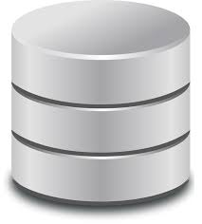
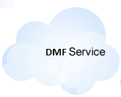


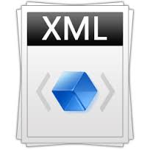


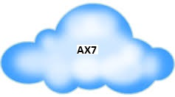
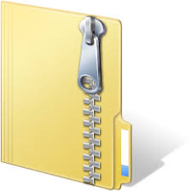
High level architecture
Pre-Process
Export to file(s)
AX 2009 Database
Data Migration
Tool
Mapping
Create Package
Import

Slide 10
Demo

Slide 11
Upgrade AX2012 to the New Dynamics AX

Slide 12
Migration Process
Start LCS Upgrade Project
Estimate
Manually migration
Complete
Auto-migrate
LCS: Auto-migrate code
LCS: Check-in upgraded code to VCTS
Create AX project in LCS
Create and link VSTS Project
Upload AX2012 model store
Provision DEV (and BUILD) boxes
Map VSTS to DEV Workspace
Resolve conflicts
Compile errors
Model split
Form migration
…etc

Slide 13
What’s really happening?
3) Rebaseline for overlayering (merge and model split)
Application Suite
Application Foundation
4) Run Auto-Migration Rules
Application Platform
2) Convert to <XML>
LCS Auto-Upgrade Service
5) Check into VSTS (code and workitems)
6) Developer one-box deploy
ModelStore
1) Upload Modelstore to LCS
7) Manually migrate (resolve unparseable files, conflicts and compile)

Slide 14
Data Upgrade
Data upgrade effort in progress.
Will support all releases of AX2012
Preview/Readiness workshops announcements to follow from Jan 2017

Slide 15
Roadmap

Slide 16
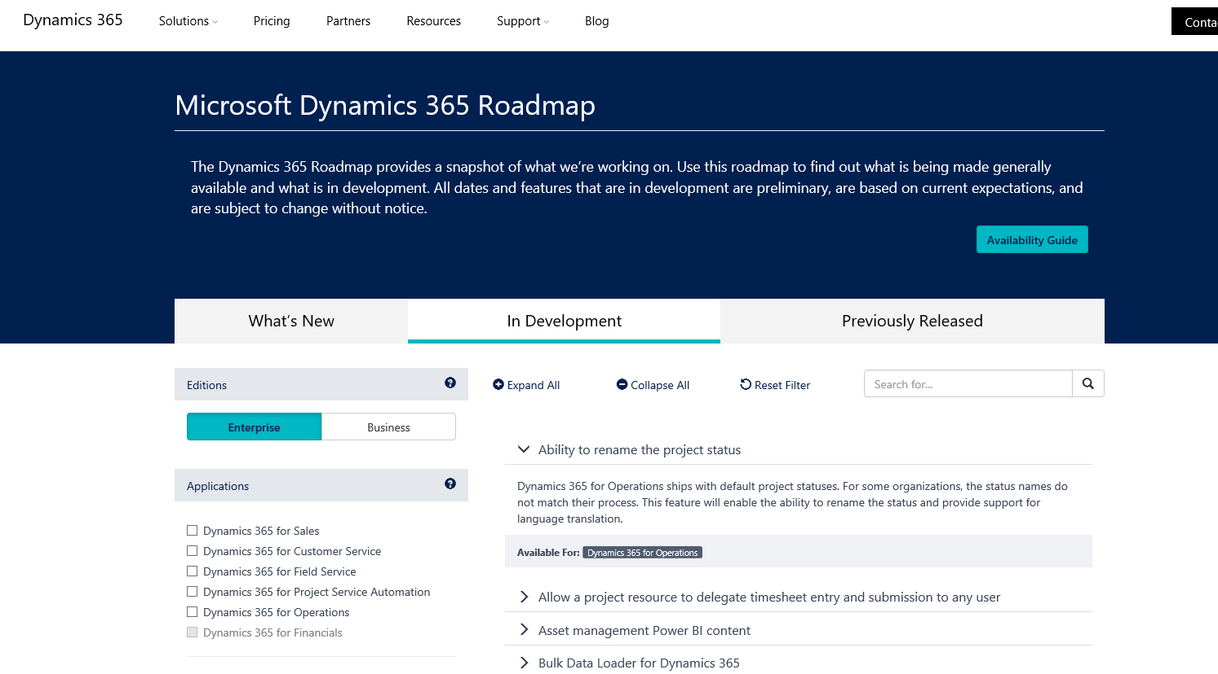
What is next official page
https://roadmap.dynamics.com/

Slide 17
Q & A

